Slide 1

SYNOPSIS Presentation
on
TimeCoins
(A Secure Share-Mapped Digital Currency)
by
Aman Kumar 202410116100020
Anand Patel 202410116100023
Deepu Kumari 202410116100057
Session:2025-2026 (III Semester)
Under the supervision of
Prof. Ms. Hunny Gaur
Department Of Computer Applications
KIET GROUP OF INSTITUTIONS, DELHI-NCR, GHAZIABAD-201206

Slide 2
Unlocking Value: The TimeCoins Vision
Introduction
Purpose
TimeCoins is a novel digital currency directly backed by shares of the TimeCoins Organisation. This unique asset-backing provides inherent stability.
To establish a secure, stable, and innovative medium for digital transactions, bridging the gap between traditional finance and decentralized assets.
Problem Solved
Impact
Cryptocurrency volatility due to lack of tangible asset backing.
Delivers a stable crypto asset, collateralized by company shares.
Traditional payment systems do not facilitate direct investment.
Integrates payments and investments into a single, seamless system.
Enables direct payment for goods/services using share-backed coins, unlike conventional shares.

Slide 3
Core Objectives: Building a Robust Platform
Our development strategy is focused on creating a secure, scalable, and user-friendly platform that addresses key market needs.
01
02
Secure REST API Backend
Intuitive React.js Frontend
Develop a resilient and secure backend infrastructure for TimeCoins, handling all critical operations.
Design and implement a responsive and smooth user experience for web and mobile interfaces.
03
04
Comprehensive User Authentication
Dynamic Wallet System
Implement robust features including login, registration, logout, and password recovery.
Create a wallet with real-time value updates, reflecting the underlying share performance.
05
06
Rich Transaction Capabilities
Success Metrics
Enable transactions that support text, media, and direct TimeCoin payments within the platform.
Measure performance based on transaction security, platform scalability, and user adoption rates.

Slide 4
Project Scope: What's Included & Excluded
Inclusions
Exclusions (Not Included in First Version)
User authentication & robust security protocols.
Public blockchain mining infrastructure.
Wallet management with dynamic value updates based on share performance.
Integration or support for external cryptocurrencies.
Direct bank account integrations.
Secure transactions: text, images, videos, and integrated payments.
Key Modules
Comprehensive transaction history and ledger tracking.
Authentication & Security
Wallet Management
Proprietary share-value mapping engine.
Messaging & Payments
Transaction Ledger
Value Mapping Engine

Slide 5



Methodology & Technology Stack
Agile Approach
Frontend
Backend
Utilizing an Agile methodology with iterative sprints to ensure flexible and responsive development.
Developed with React.js for a dynamic and intuitive user interface.
Built on Spring Boot (Java) with secure REST APIs for robust server-side operations.
Database
Security
MySQL for reliable and scalable data storage.
JWT authentication and advanced encryption techniques ensure data integrity and user privacy.

Slide 6
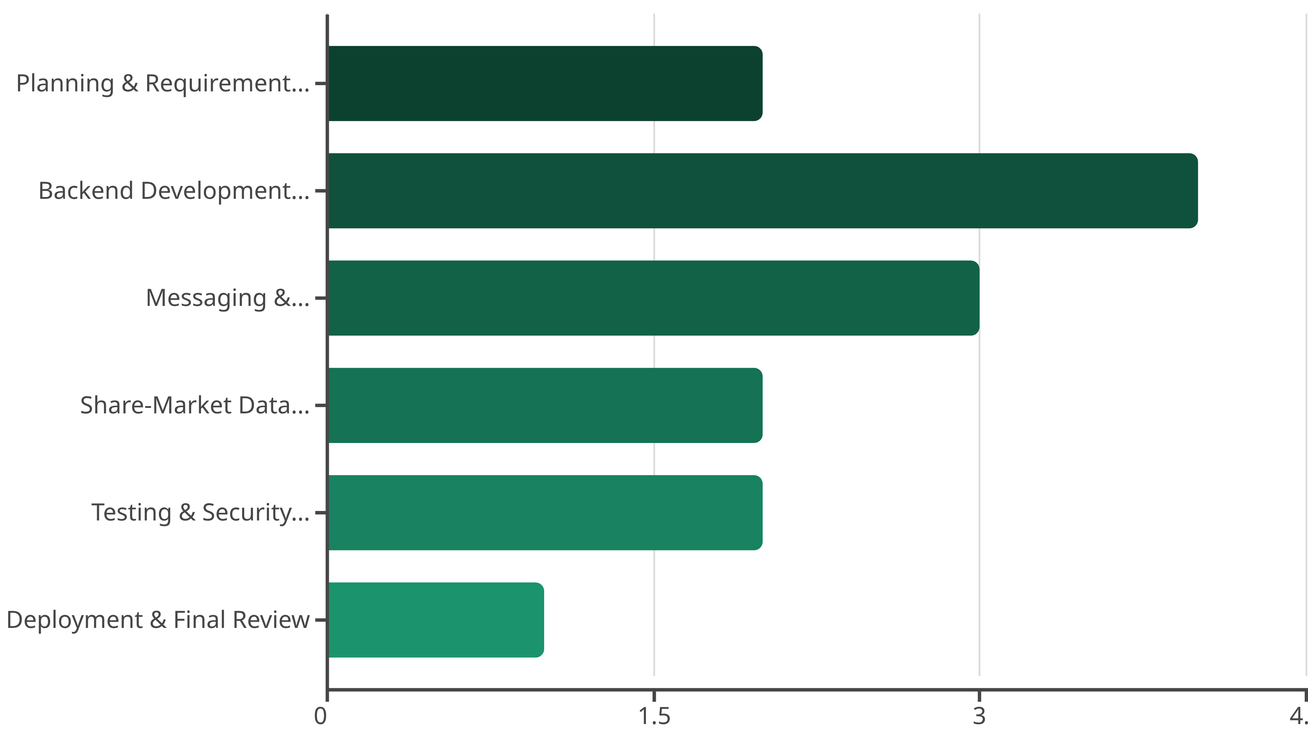
Our phased approach ensures efficient development and timely delivery of each critical module.
Project Timeline
This Gantt chart visualizes our 14-week development roadmap, highlighting key milestones and their allocated durations.
This Gantt chart visualizes our 14-week development roadmap, highlighting key milestones and their allocated durations.

Slide 7

Project Outcome
Final Result:
Future Extensions:
Fully functional web application for secure TimeCoin transactions.
Mobile application development.
Research paper on share-backed cryptocurrencies.
Wallet system with fluctuating value tied to shares.
Patent filing for coin-value fluctuation mechanism.
Messaging system with integrated payments.

